Slide 1
SharePoint Training
Administrative Group Summit

Slide 2
Contents
Why SharePoint
Browser Requirements
Terminology
Lists and Libraries
  Creating a List or Library
  Adding Columns
Uploading Files
Updating List/Library Columns
Updating Files
  Opening Files
  Editing Files
  Updating File Properties in Word

Slide 3
Contents
  Updating Files Properties in Excel
  Updating Files
  Saving Files
  Co-Authoring
  Checking Out Files
  Checking In Files
Viewing Prior Versions of Files
Adding and Working with Folders
  Windows Explorer View
  Deleting Temporary Internet Files
Alerts
Help and Information

Slide 4
Why SharePoint
Version control
  Each library can be set to keep prior versions of a file. Files with the same name will overwrite each other to ensure the most recent one is available.
  By eliminating the practice of emailing files, you can be sure that the single version on SharePoint is the most current version without guessing.
  Eliminate rework and save time.
Accountability
  Each save records who the file was last modified by.
  Comments can be used to alert coworkers of changes and pertinent information.
Security
  Security groups can be created to meet group needs.
  Each document library, calendar, and discussion group can be made accessible accessible only to the members in the allowed groups, at the allowed level.
  Permissions can be customized down to the file level, if needed.
Centralized communication
  Using discussion boards instead of email for information that needs to be dispersed to an entire team ensures that it doesn’t get lost in an inbox.
  Information remains easily accessible to all team members.
Back to Contents

Slide 5

Browser Requirements
Internet Explorer (IE)
  IE is the only browser fully compatible with SharePoint.
  Firefox and Chrome are incompatible. While they will allow you to view some areas seamlessly, they cannot complete all the functions available or utilized by SharePoint sites.
Back to Contents

Slide 6
Terminology
Alert
  A notification to users that there are changes to existing information or new information in a specified location. Alerts can be set on individual files, lists, libraries, and pages.
Discussion board
  A central location t share information under multiple topics.
Document library
  A list where documents and folders are stored. The document library settings control versioning settings, workflow settings, and information policies.
List
  A list is a collection of information items displayed in an area or on a site. List types include: Announcements, Links, Contacts, Events, Tasks, and Issues.
Page
  A user-created area on a SharePoint site for displaying content.
Public-facing site
  A SharePoint site that is accessible by all LM and LMS employees.
Security group
  A collection of defined users that can be granted permission to documents, libraries, lists, and sites as a group.
Back to Contents

Slide 7
Terminology
Site
  A complete SharePoint site stored in a named portion of the top-level site.
Subsite
  A named subdirectory of the top-level site that is a complete site. Each subsite can have independent administration, authoring, and browsing permissions from the top-level sites and other subsites.
Team site
  A SharePoint site accessible only by the team members defined in security or
  domain groups.
View
  A named collection of settings for querying and displaying items or documents in a SharePoint list or library. There are two types of views: Personal, which can be used only by the user who creates them; and Public, which can be used by all users who have access to the site.
Web part
  Customizable page element that can be added to SharePoint pages.
Workflow
  The automation of processes, where documents and tasks are passed automatically from one user to another for action, according to a set sequence.
Back to Contents

Slide 8
Lists and Libraries

Slide 9
Lists and Libraries
Lists
Libraries
Made up of line items
Can hold attachments
Created by adding information lines
Made up of files including documents, spreadsheets, slide presentations, images, and more
Created by uploading or creating a file
Back to Contents

Slide 10
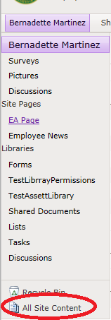

Creating a List or Library
To create a new list or library:
Go to All Site Content, located on the bottom of the left-hand navigation menu on any page.
Click Create at the top of the page.
Back to Contents

Slide 11
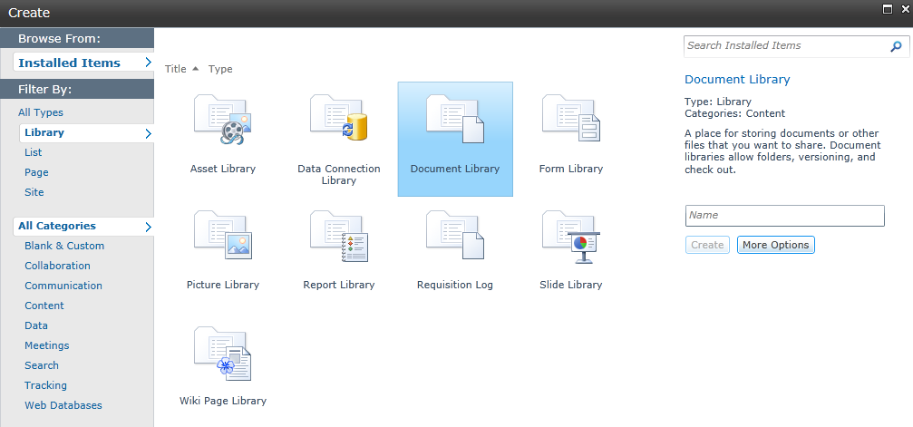
Creating a List or Library
Select the thing you want to create. Use the filters on the left to display fewer options.
Give the list or library a name and click Create.
More Options will give you the choice to add a link to the left-hand navigation menu.
Back to Contents

Slide 12
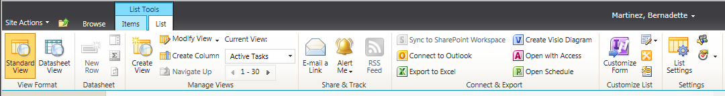
Adding Columns
You can add existing site columns or create custom columns for any list or library.
To add columns, navigate to the list or library and go to List (Library Tools > List (Library) > List (Library) Settings.
Back to Contents

Slide 13
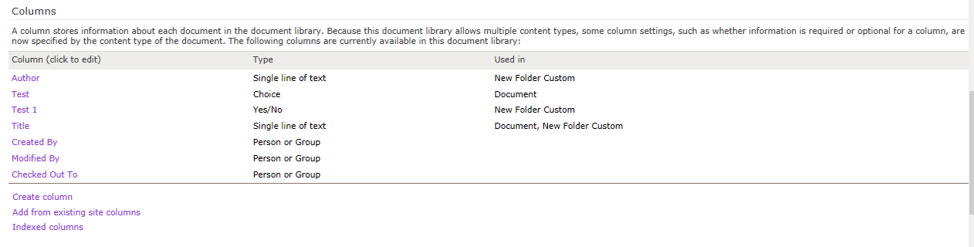
Adding Columns
Under Columns select Add from existing site columns or Create column based on your needs.
Back to Contents

Slide 14
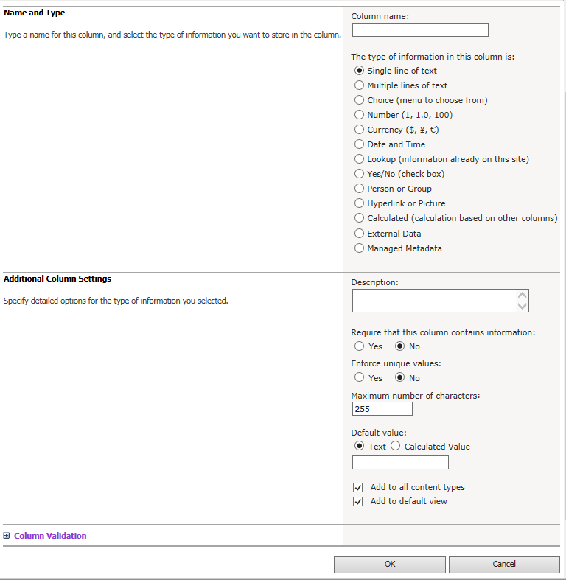
Adding Columns
If choosing to create a column, select the options for the column.
After making the column selections, click OK.
Back to Contents

Slide 15

Questions
Back to Contents

Slide 16
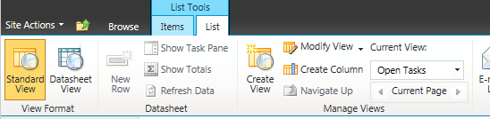
Creating Views
Multiple views can be created for any list or library by going to List (Library) Tools > List (Library) > Create View.
Back to Contents

Slide 17
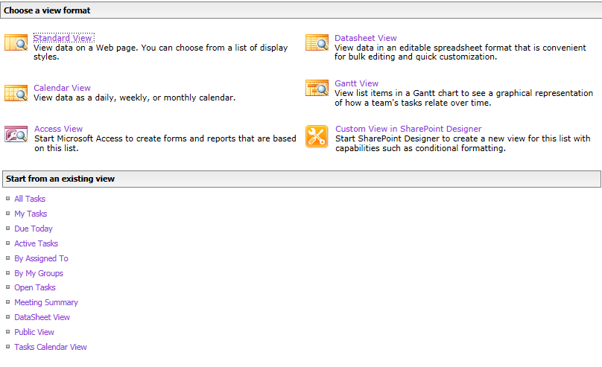
Creating Views
Select one of the formats to begin from scratch or select an existing view to modify it to create a new one.
Back to Contents

Slide 18
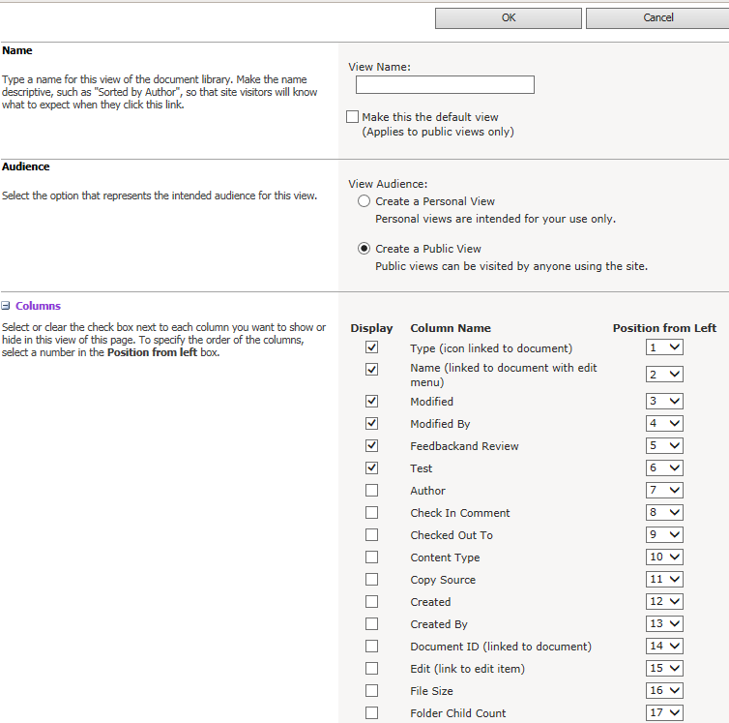
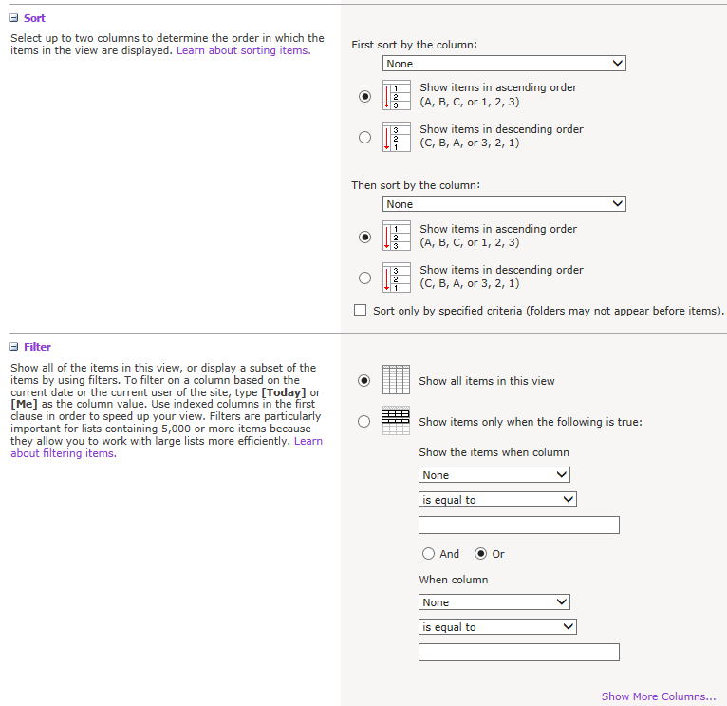
Creating Views
Name the view, select the audience (public or personal), the columns to display, and sorting and grouping options.
Back to Contents

Slide 19
Questions
Back to Contents

Slide 20
Uploading Files

Slide 21
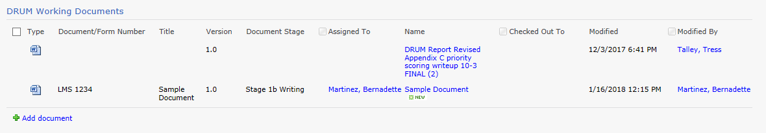
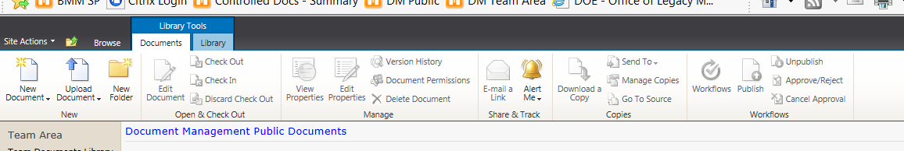
Uploading Files
To upload a new file, navigate to your desired library and click Add document in the lower left of the library.
You can also go to the ribbon and click Upload document.
Back to Contents

Slide 22
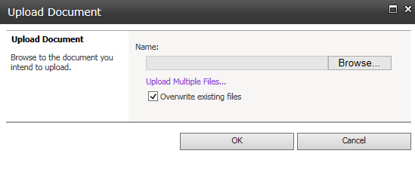
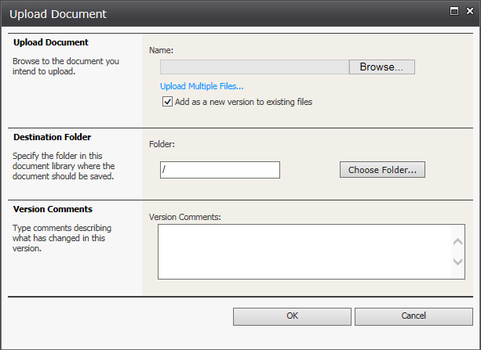
Uploading Files
Click Browse to locate a single file for upload.
Select the folder, if necessary, by clicking Choose Folder…(this will populate automatically if you are in a folder already).
  Note: SharePoint’s filtering and view
  options make folders unnecessary in
  many cases.
Network folder file names are limited to 250 characters including the entire file path, so names should be concise and abbreviated where possible.
Click OK to upload the file.
Back to Contents

Slide 23
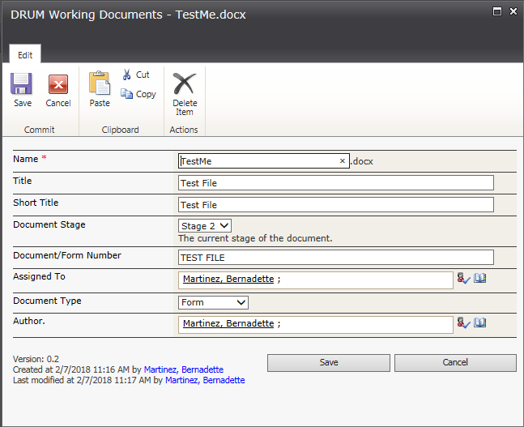
Uploading Files
When your file has uploaded, the document properties window will appear.
The Name field is the file name of the uploaded file.
If there is metadata in the file, it will populate the Title field.
Enter any other information that has been set up in the appropriate areas and click OK.
Your screen will reload and you will see the file in the library.
Back to Contents

Slide 24
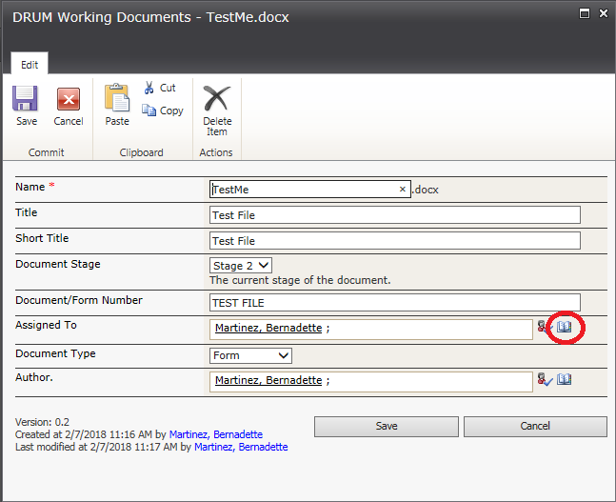
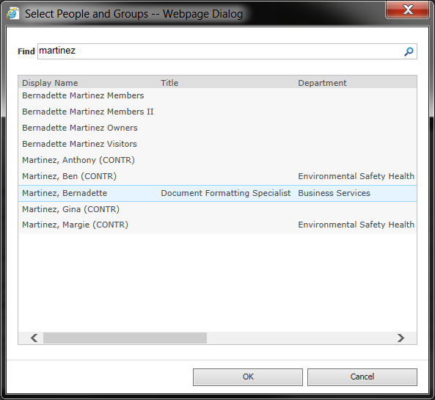
Uploading Files
Note:
Some fields, like the Assigned To field, can be created as lookup fields. Type the name as last name, first name and hit enter. If there are any spelling errors, it will not save. Click the book icon to search for names. Select the appropriate name from the list and click OK.
Back to Contents

Slide 25
Questions
Back to Contents

Slide 26
Updating List/Library Columns

Slide 27
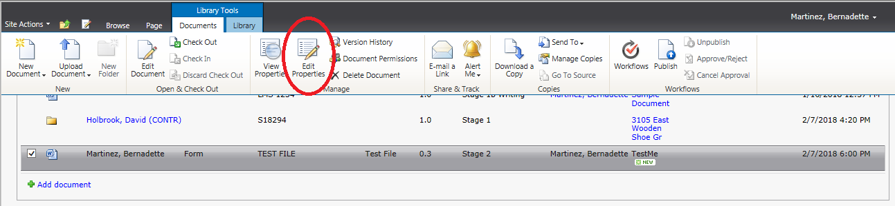
Updating List/Library Columns
When you update the properties of a document or folder, you will be prompted to check out the item. There are two methods to do so.
Method 1
Check the box in front of the document.
Click Edit Properties on the Library Tools > Documents ribbon.
Back to Contents

Slide 28
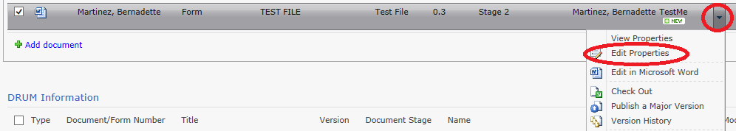
Updating List/Library Columns
When you update the properties of a document or folder, you will be prompted to check out the item. There are two methods to do so.
Method 2
Click the dropdown arrow next to the file name.
Click Edit Properties in the drop down menu.
Back to Contents

Slide 29
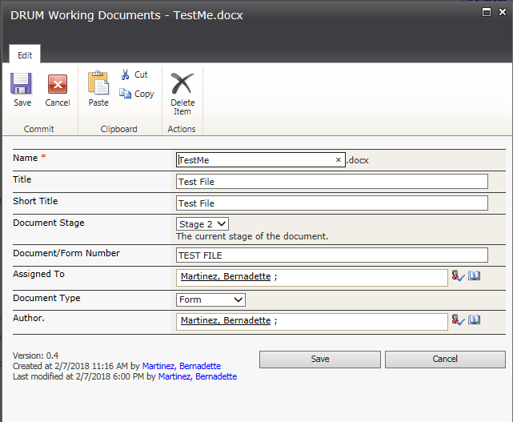
Updating List/Library Columns
From this screen you can update all the properties of the document. Make the necessary updates and click Save.
This does not check in the file. Until the file is checked in, updates will not be visible to anyone else.
Back to Contents

Slide 30
Questions
Back to Contents

Slide 31
Updating Files

Slide 32
Updating Files
You must use the Internet Explorer browser to utilize SharePoint pages. Firefox and Chrome are not compatible with SharePoint functions. If you encounter anything strange, especially forced downloads of files when you attempt to open them, check your browser first.
  SharePoint will time out after 30 minutes of inactivity. Best practice is to save your work often, just as you would with offline files. If you have a document open and need to leave your desk for any reason, save the file first. This will ensure all your work is saved and none of your changes are lost.
  If SharePoint is being used to maintain version control, all documents should be worked on SharePoint exclusively. In this case, do not download documents from SharePoint to work on them. All files must be opened, worked on, and saved in SharePoint, not on your hard drive. In order to maintain version control, it is imperative that only one copy of the file be used.
Back to Contents

Slide 33
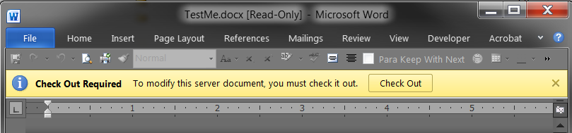
Opening Files
To open a file, click on the file name in the library you are working in (shared documents, team information, etc.). File names will always display as blue hyperlinks. The file will open in the appropriate Microsoft Office program.
Click the file name only once. Be patient. If multiple copies open, you may inadvertently start working on a read-only copy and you will not be able to save your work. If multiple copies open, ensure the one you ultimately work on does not have [Read-Only] in the heading. If it does, close it and reopen the file from SharePoint.
Back to Contents

Slide 34
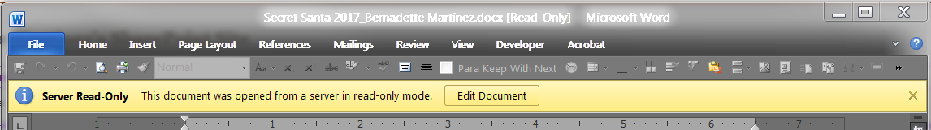
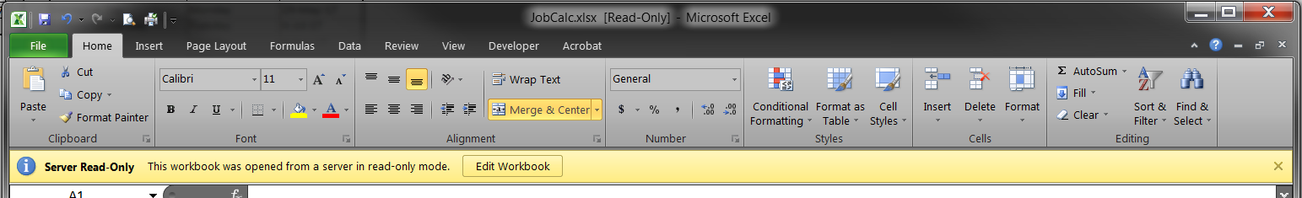
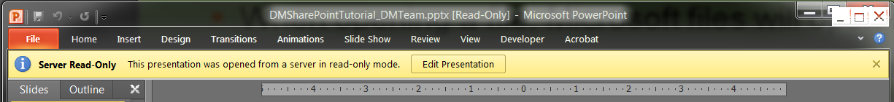
Editing Files
When opening a file, Microsoft files will open in read-only mode.
Click Edit Document in the yellow information ribbon across the top of the file.
The file will reload and you will be able to edit it normally.
Back to Contents

Slide 35
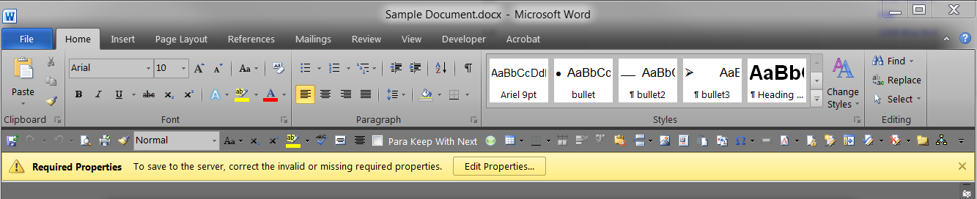
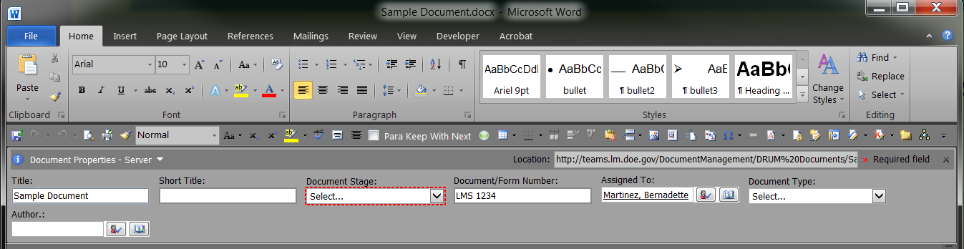
Updating File Properties in Word
If the file properties have values that do not correspond to the current options in SharePoint (for example, if choices were updated), you will see a yellow ribbon prompting for changes. Click Edit Properties to display the properties panel in the document.
The values that require updating will highlight themselves in a broken red outline. Select from the provided options or update the information in the necessary manner to update the file.
Back to Contents

Slide 36
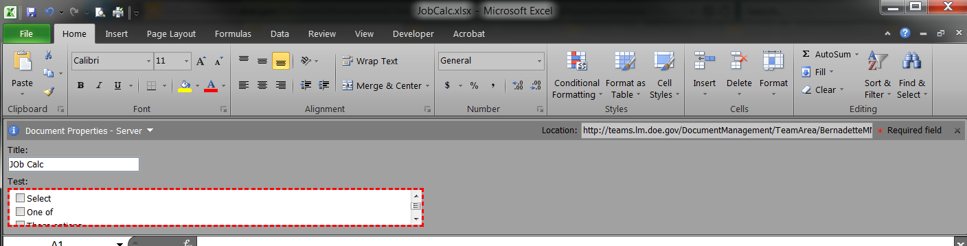
Updating File Properties in Excel
If the file properties have values that do not correspond to the current options in SharePoint (for example, if choices were updated), you will see a yellow ribbon prompting for changes. Click Edit Properties to display the properties panel in the document.
The values that require updating will highlight themselves in a broken red outline. Select from the provided options or update the information in the necessary manner to update the file.
Back to Contents

Slide 37
Questions
Back to Contents

Slide 38
Updating Files
Once you open a file for editing, you can make changes to it as you normally would. There are no differences between updating the content of a SharePoint file and an offline file.
Track Changes and SharePoint
  If Track Changes are on, as is standard with our files, you will not see other users’ updates in real time. You will still see notifications on the bottom of your screen indicating that there is new information available.
Some file types, such as Excel, cannot be opened in the web view if certain features are enabled.
Back to Contents

Slide 39
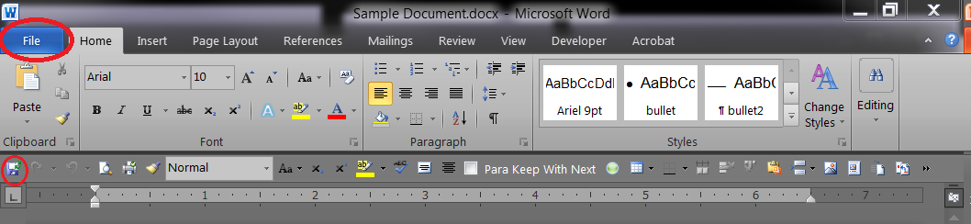
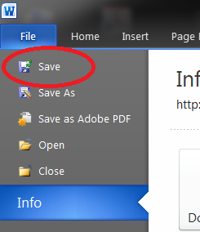

Saving Files
Update the file as needed in SharePoint. When you are ready to save, click the save icon, use Crtl + S on the keyboard, or go to the file menu and click Save. The file will be updated on SharePoint and anyone who opens it will see the most recent versions of the file.
Server copies of the file will always have a green arrow around the save icon. Always save to the server.
Back to Contents

Slide 40
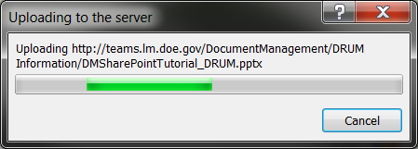
Saving Files
When you save a Microsoft file, you will see a status bar in the lower right corner of the document. It is easy to miss if you aren’t looking for it.
PDF files do not have this status bar. If it was opened from SharePoint, it will save to the server.
When working with larger files or at times when the server is slow, a popup window will appear indicating the file is updating. Be patient and wait for it to complete. Some files become very large when many images are added. The traffic on the network, the file size, and the power of our machines all impact the time it takes to save files. The file will upload and save to the library as intended.
Back to Contents

Slide 41
Questions
Back to Contents

Slide 42
Co-Authoring
SharePoint offers a feature called co-authoring. This allows multiple users to work on the same file simultaneously.
Pros
Faster
Real-time updates
Collaborative work environment
Cons
No real-time updates if using Track Changes
Refreshing to see changes
Back to Contents

Slide 43
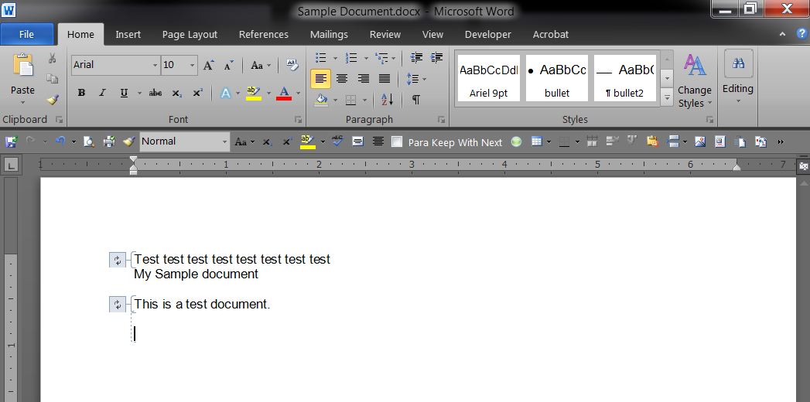
Co-Authoring
If there are changes made to the file by another user, you will be alerted. The updated areas will be bracketed and refresh arrows will be around the updated text, indicating a refresh is needed.
Back to Contents

Slide 44
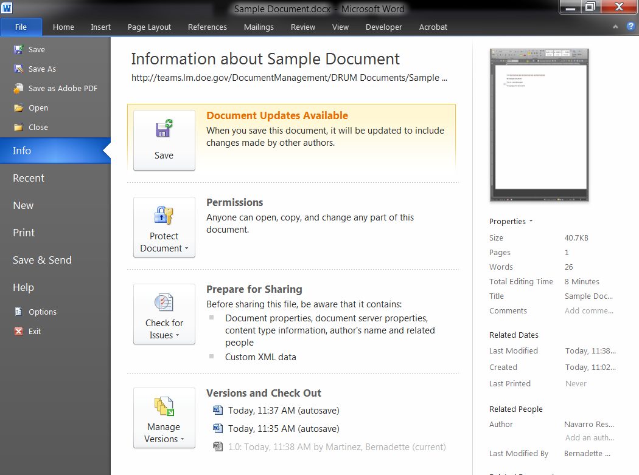
Co-Authoring
If you use the file menu to save, you will see a notification of updates in the file menu as well.
Back to Contents

Slide 45
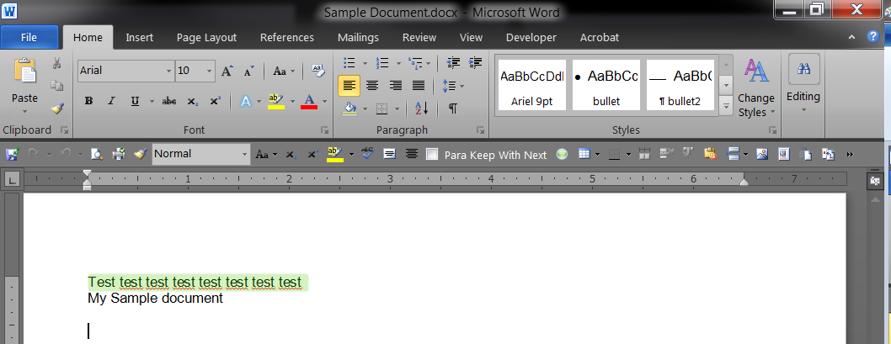
Co-Authoring
After you save to refresh the file, the updated areas will be highlighted for you to review.
Back to Contents

Slide 46
Questions
Back to Contents

Slide 47
Checking Out Files
If it is absolutely necessary to be the only person with access to a file, you can check out a file for editing. This should only be done when files are in the formatting and editing stage or a situation requires it. Otherwise, this should be avoided.
When a file is checked out, other group members cannot make updates or see updates until it is checked in by the person working on it. If that person is out or for any reason doesn’t have access to SharePoint and the file is needed, it can be force checked in, but all changes made will be lost. There is no way to retrieve this information.
Unless the version cannot change (as in the formatting and editing stage), there are very few practical reasons for files to be checked out.
Back to Contents

Slide 48
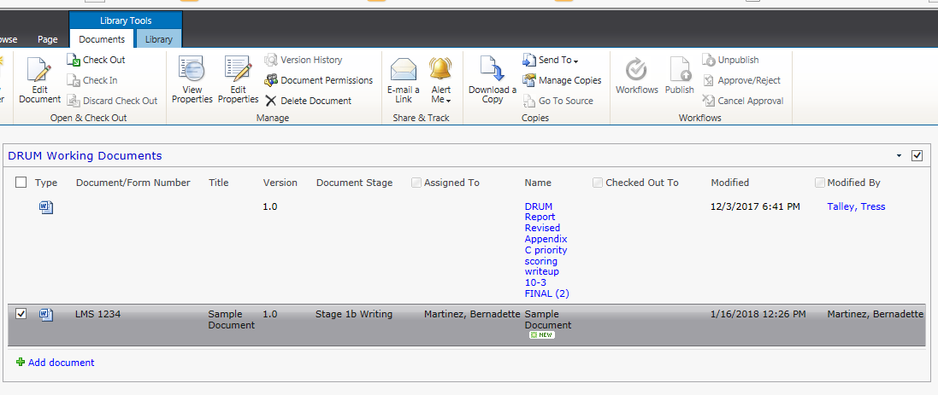
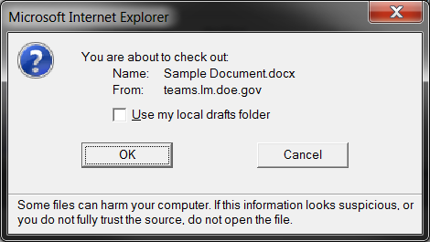
Checking Out Files
You can check out files manually or in the file. To check out a file manually:
  Check the checkbox in front of the file row. You can select multiple files to check out simultaneously.
  On the top ribbon under Library Tools, select Check Out.
  Click OK on the pop-up window.
Back to Contents

Slide 49
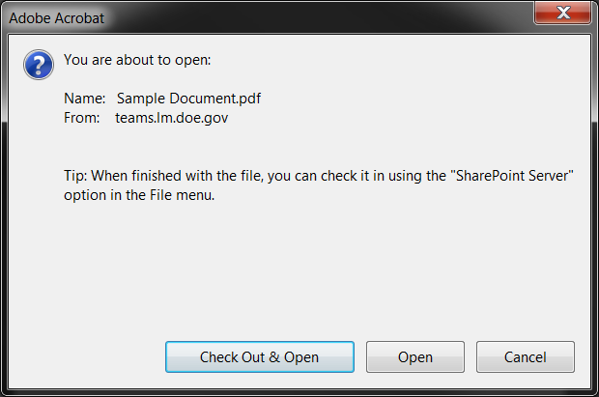
Checking Out Files
PDF files will prompt you for check out with a dialogue box.
Click Check Out & Open if you want to make any changes, including comments, to the file.
Back to Contents

Slide 50
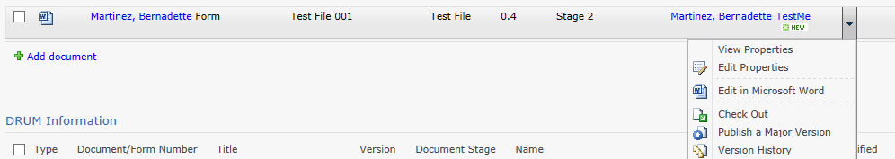
Checking Out Files
You can also click the dropdown arrow to the right of the file name select Check Out.
Back to Contents

Slide 51
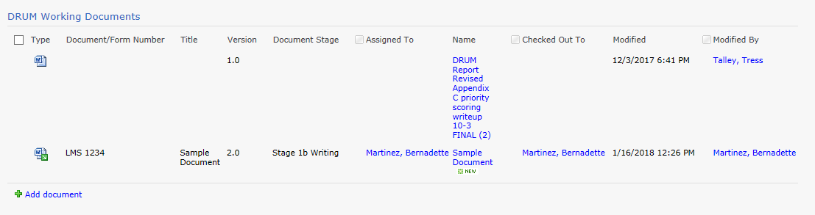
Checking Out Files
The file will not open automatically. You must still click on the file name to open the document. The library will update to display who has the file checked out.
Checked out files will always have a green downward-facing arrow to indicate that status.
Back to Contents

Slide 52
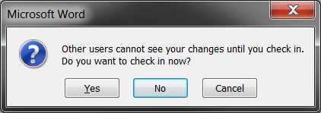
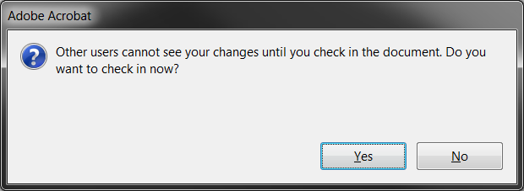
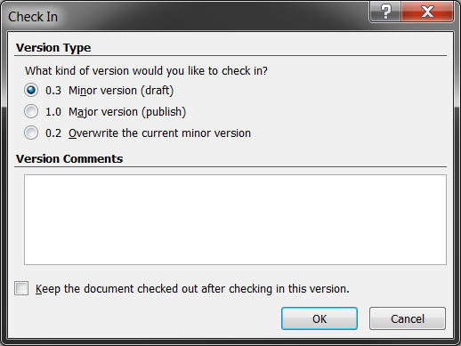
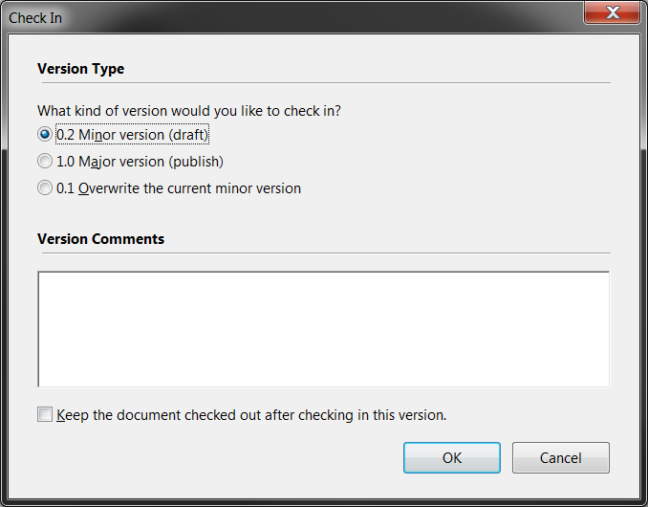
Checking In Files
Checking in a file can be done by closing the file. Using the X in the upper right corner or by going to File > Exit menu will prompt a dialog box to check in the file.
You do not have to check in a file until you are done with your work. Saving the file will save your work, but it will not be visible to others until you check in the document.
Click Yes to check in the file.
A second dialog will pop and prompt you for the version you want to save and a comment box.
If you want others to be able to see your changes, but continue working without others editing a file, check the box in front of “Keep the document checked out after checking in this version.”
Click OK to save.
Back to Contents

Slide 53
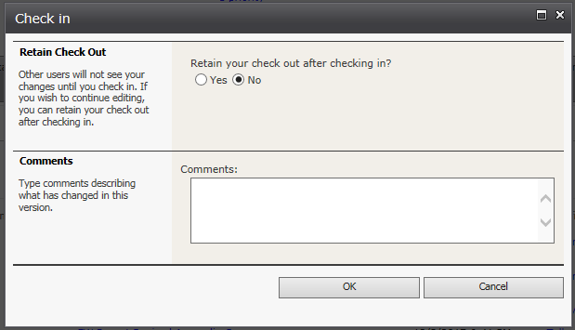
Checking In Files
A pop-up will appear to enter comments about the changes made. Make sure the first question remains defaulted to “No” and click OK. The page will refresh and the file will be updated in the library.
Back to Contents

Slide 54
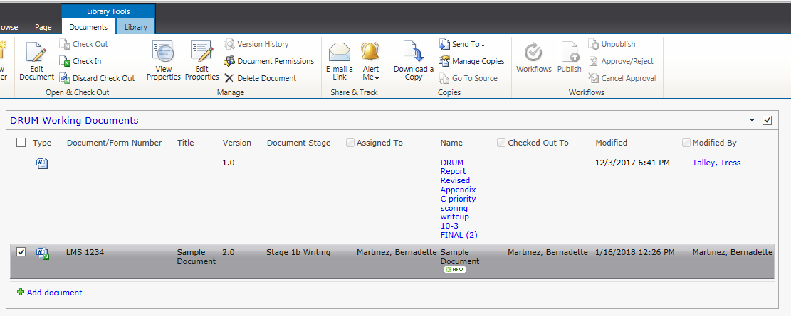
Checking In Files
To check in a document manually, click the checkbox in front of it and click Check In from the Library tools ribbon.
If you checked out the file in error and have no changes to make, you can also click Discard Check Out.
Back to Contents

Slide 55
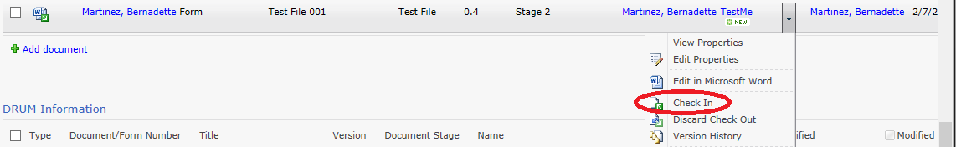
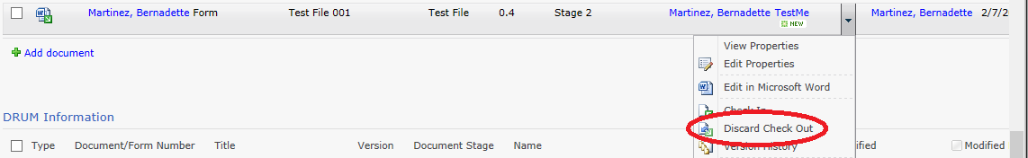
Checking In Files
You can also click the dropdown arrow to the right of the file name select Check In or Discard Check Out. Checking in the file this way will prompt the same pop up for version and comments.
Back to Contents

Slide 56
Questions
Back to Contents

Slide 57
Viewing Prior Versions of files

Slide 58
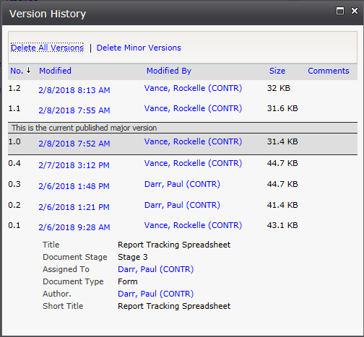
Viewing Prior Versions of Files
You view the version history of a file in SharePoint. Click the dropdown menu next to any file and select Version History.
This will show you the version, the date and time it was modified, who modified it, and the size of the file along with the file properties.
This will not show changes to the file.
Microsoft provides instructions for viewing prior versions here.
Back to Contents

Slide 59
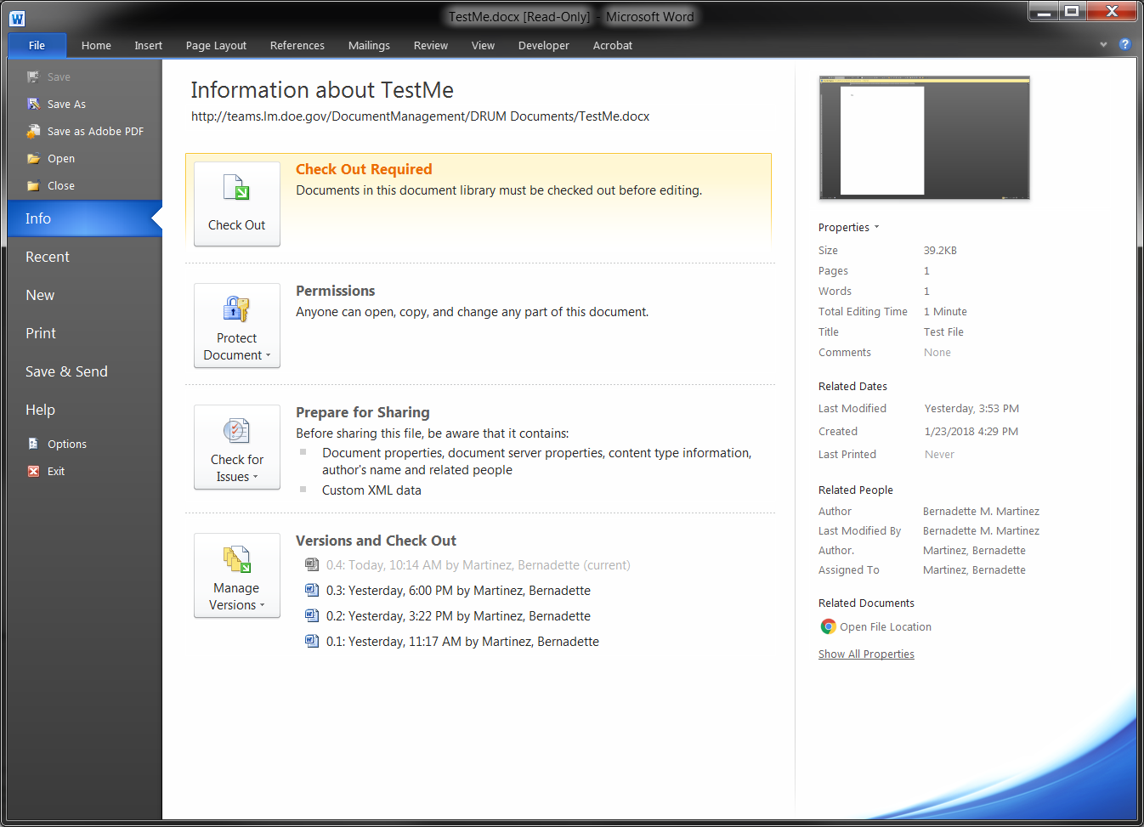
Viewing Prior Versions of Files
You can view previous versions of a file in Word, Excel, or PowerPoint without checking out the file.
To view a previous version, open the file and go to the File menu.
Back to Contents

Slide 60
Viewing Prior Versions of Files
Go to Versions and Check Out.
Click on any version to open a read-only copy of that version.
Back to Contents

Slide 61
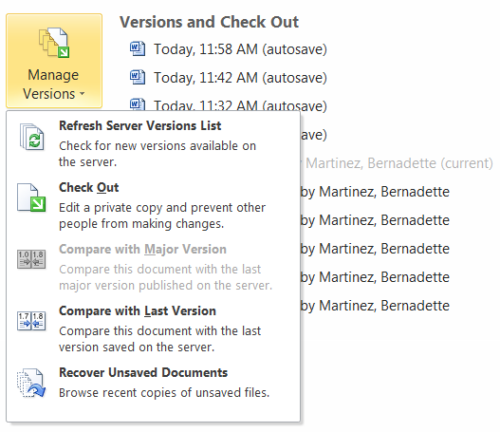
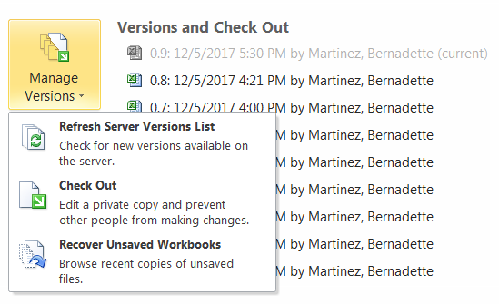
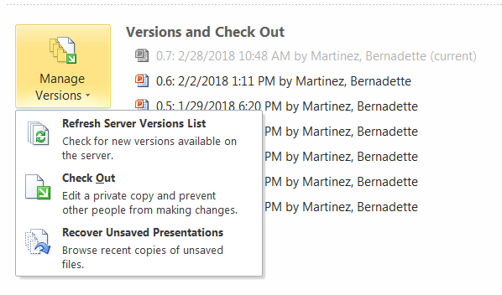
Viewing Prior Versions of Files
There is a drop down menu under Manage Versions. Word, Excel, and PowerPoint will allow you to refresh the version list, check out the file, and recover unsaved files from this list.
Word will also allow you to compare versions in a unique window.
Word
Excel
PowerPoint
Back to Contents

Slide 62



Viewing Prior Versions of Files
The previous version will open in a separate file. For Word, you will have the option to compare to the most recent version or restore the previous version. For Excel and PowerPoint, you will have the option to restore the previous version as the most current.
Back to Contents

Slide 63

Viewing Prior Versions of Files
Comparing the file in Word will open a window highlighting the changes.
Back to Contents

Slide 64
Viewing Prior Versions of Files
If you attempt to restore the file without checking it out, you will receive an error message.
Files generally will not need to be restored.
Back to Contents

Slide 65

Viewing Prior Versions of Files
You can view prior versions of a file in Word without checking out the file.
To view a prior version, open the Excel file and go to the File menu and go to Versions and Check Out.
Prior versions can be viewed and restored, but Excel does not offer a compare function.
Back to Contents

Slide 66
Questions
Back to Contents

Slide 67
Adding and working with Folders

Slide 68


Adding and Working with Folders
You can add folders to any SharePoint library to organize files. To add a folder, go to the library you want to add a folder to. Under the Library Tools > Documents menu, click New Folder.
Add the name of the folder in the Name field and click Save.
Back to Contents

Slide 69

Adding and Working with Folders
To add new documents to the folder, click the name of the folder under the Name column in the library. The list will reload to display files under that folder or an empty folder, if no files have been added.
Click Add a document and follow the normal upload procedure to upload files directly to the desired folder.
Back to Contents

Slide 70

Windows Explorer View
To add existing files to the folder, go to the Library Tools > Library menu and click Open with Explorer in the ribbon.
Back to Contents

Slide 71


Windows Explorer View
The first time you open this each day, you will receive a login screen. Use your Windows/McAfee login information.
  Do not use your PIV information.
  Do not click “Remember my credentials”
  If you get an error message, you need to delete the temporary files from Internet Explorer, follow the steps in Deleting Temporary Internet Files.
Back to Contents

Slide 72

Windows Explorer View
A typical folder window will open on your desktop. This functions like any other Windows folder.
Back to Contents

Slide 73

Deleting Temporary Internet Files
If you cannot open the Windows Explorer view from SharePoint at any time or receive an error message stating the client doesn’t support opening the list with Windows Explorer, these steps must be taken.
Back to Contents

Slide 74


Deleting Temporary Internet Files
Open Internet Explorer and go to Tools > Internet options.
You can also access the gear in the upper right corner and select Internet options.
Back to Contents

Slide 75

Deleting Temporary Internet Files
Click Settings.
Back to Contents

Slide 76

Deleting Temporary Internet Files
Click Temporary Internet Files > View Files.
Back to Contents

Slide 77

Deleting Temporary Internet Files
In the folder that opens, select all files and delete them.
Back to Contents

Slide 78
Deleting Temporary Internet Files
Click OK to close the two open system windows. You should now be able to open the Windows Explorer view in SharePoint.
Back to Contents

Slide 79
Questions
Back to Contents

Slide 80
Alerts

Slide 81

Alerts
Alerts let you know when a document, list, or library is updated based on criteria you set.
To set an alert on a list or library, navigate to the list or library. Under Library Tools > List (Library) click the dropdown menu under Alert Me and select Set alert on this list (library).
Back to Contents

Slide 82

Alerts
Select the criteria for the alert and click OK.
Libraries and lists will have different options.
Back to Contents

Slide 83

Alerts
To delete or update an alert on a list or library, navigate to the list or library. Under Library Tools > List (Library) click the dropdown menu under Alert Me and select Manage My Alerts.
Back to Contents

Slide 84

Alerts
Click the alert name to modify it. To delete an alert, click the checkbox and click Delete Selected Alert.
Back to Contents

Slide 85
Questions
Back to Contents

Slide 86
Help and Information

Slide 87
Help and Information
The SharePoint How-To site has a great deal of information available for training, knowledge, and instruction.
The FAQ page has many common questions answered.
If there are network issues, check your email for an Employee News or LM Information Management message.
If you want to have a more intensive, self-guided explanation of SharePoint, I recommend the following beginner-level Lynda.com presentations. Lynda.com is free to use with a Mesa County
library card.
  SharePoint 2010 Essential Training
  Learning SharePoint 2010
Back to Contents

Slide 88
Questions
Back to Contents

